Slide 1
Myers-Briggs Personality Type Classifications
By Alex Simon

Slide 2

Define the problem:
Can we determine an individual’s personality type based on their written communication?

Slide 3
Basic predictions
“Let’s make a plan and have a backup plan ready too.”
“Let’s play it by ear.”
 | MBTI: | Judgers | Perceivers
Judgers | Perceivers

Slide 4
Basic predictions
“Everyone knows that’s impossible. You can’t do it.”
“How can we do this?”
 | MBTI: | Sensors | iNtuitives
Sensors | iNtuitives

Slide 5

2. Obtain the data:
Myers-Briggs personality tags on Reddit users and their content
Zenodo

Slide 6

3. Explore the data:
~1.8 million rows of comments
Columns of MBTI and bodies of text
Used NLP to remove junk (extra characters, urls, smileys, etc)
Significantly larger quantity of iNtuitive data than Sensor data.
Balance of types not reflective of actual population
Types were inconsistent; entered in various formats, often with unnecessary information
Some alleged to be one or another (INFP or INFJ)

Slide 7
Personality type inputs
ESFP esfp
[ESFP] [esfp]
☆ESFP☆
Party Like an ESFP
ESFP: the Miley Cyrus
ISFJ isfj
[ISFJ] [isfj]
☆ISFJ☆
ISFJ/ISFP
ISFJ - I don't wanna hang out

Slide 8
4. Model the data:
Four models for each component of the MBTIs:
Attitude, Perception, Decision-making, Lifestyle
Logistic Regression
Multinomial NB
Random Forest
Count Vectorizer and TFIDF Vectorizer

Slide 9
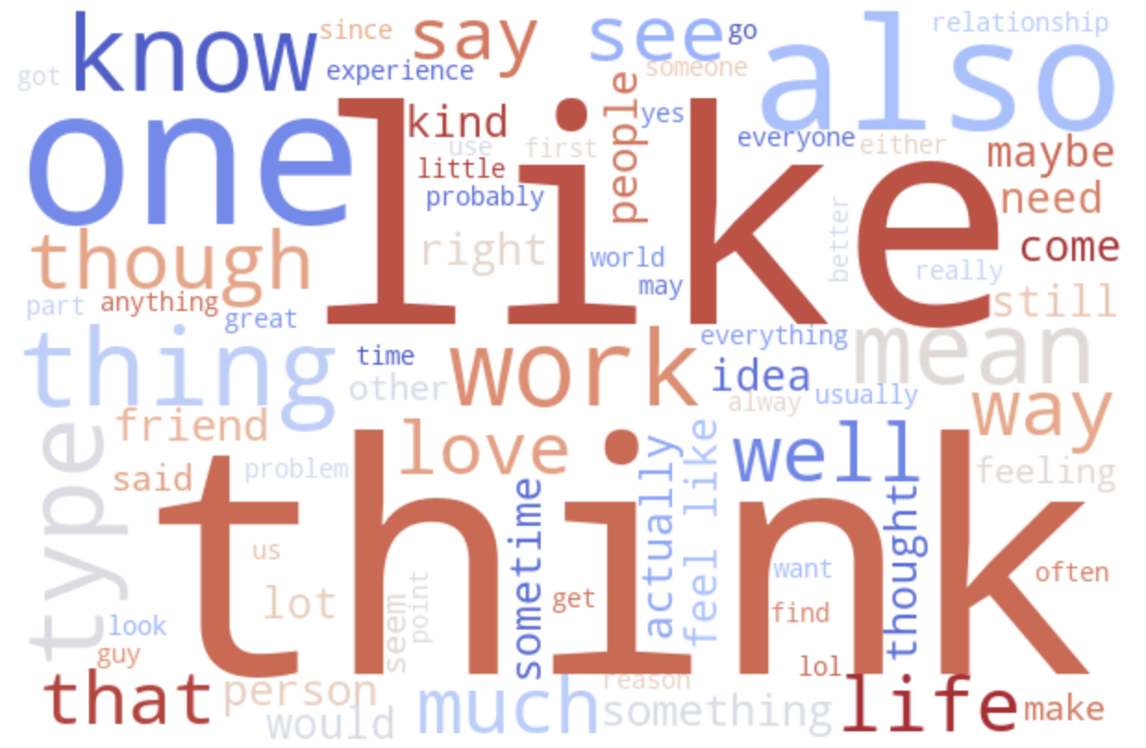
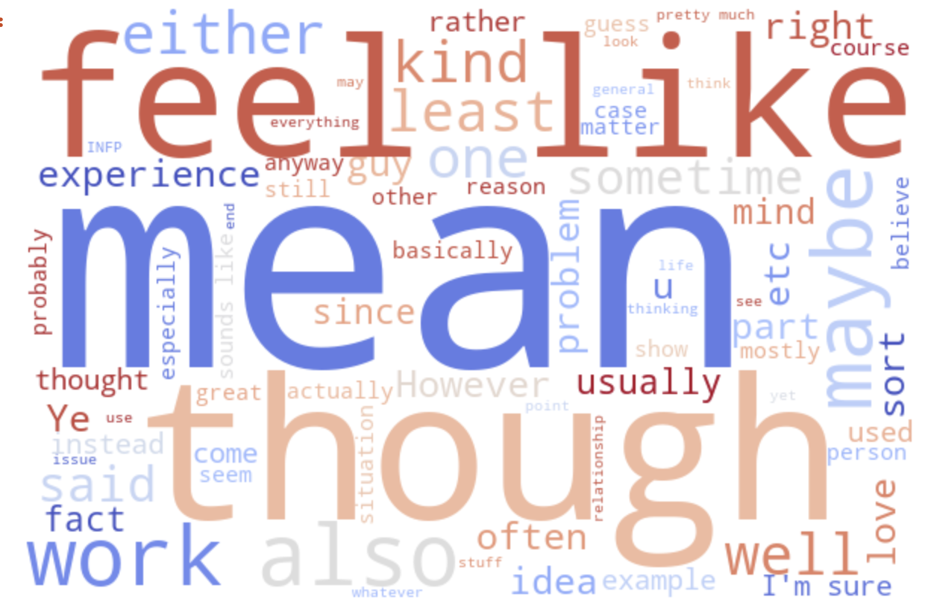
Attitude
Extroversion & Introversion

Slide 10

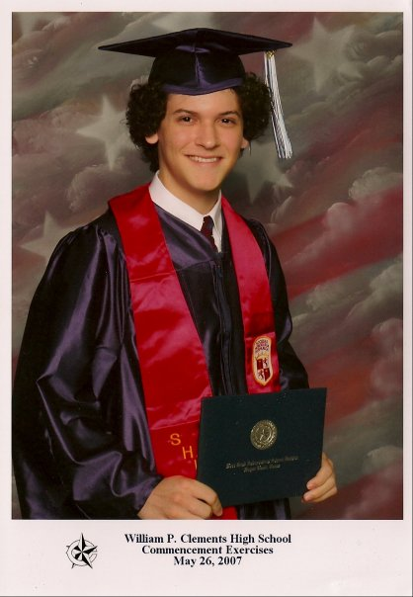
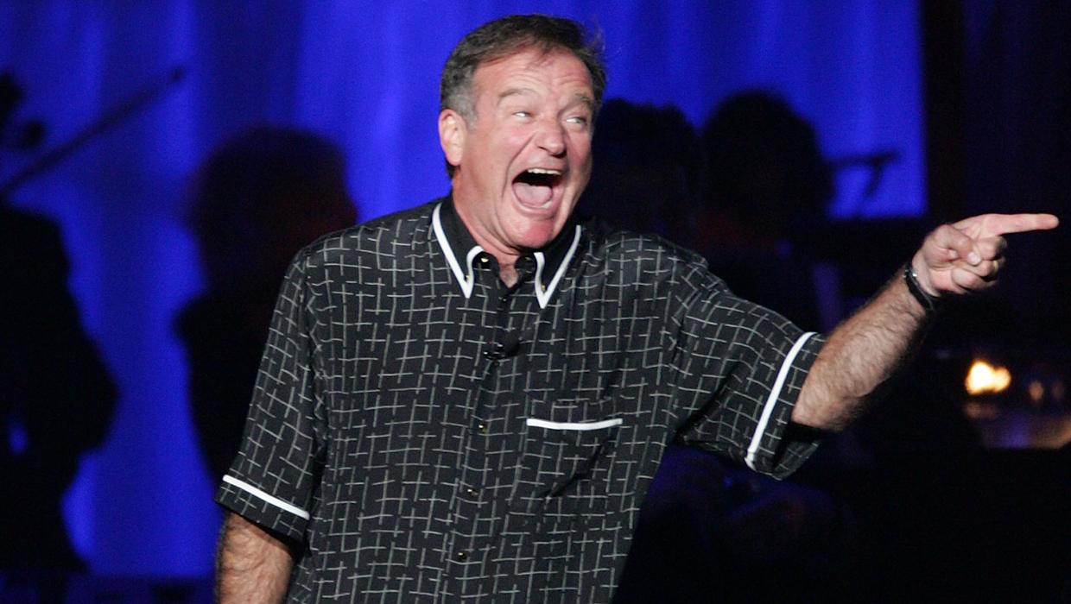
Well known extroverts

Slide 11
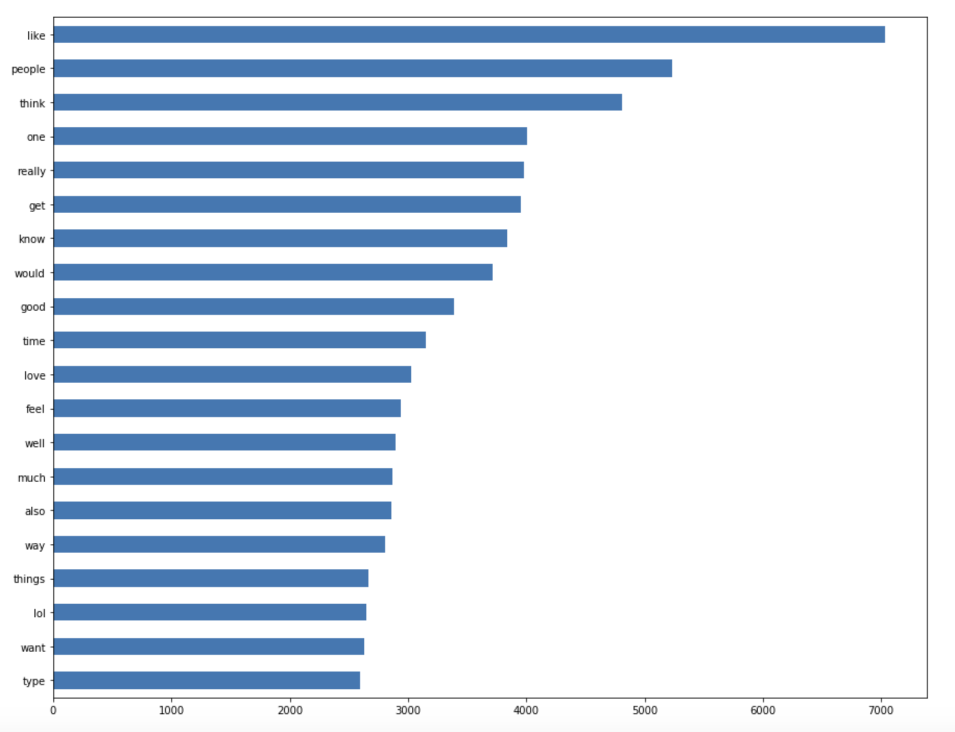

Slide 12
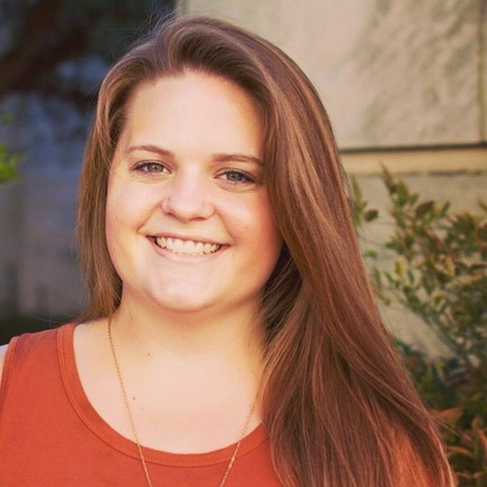


Well known
introverts

Slide 13
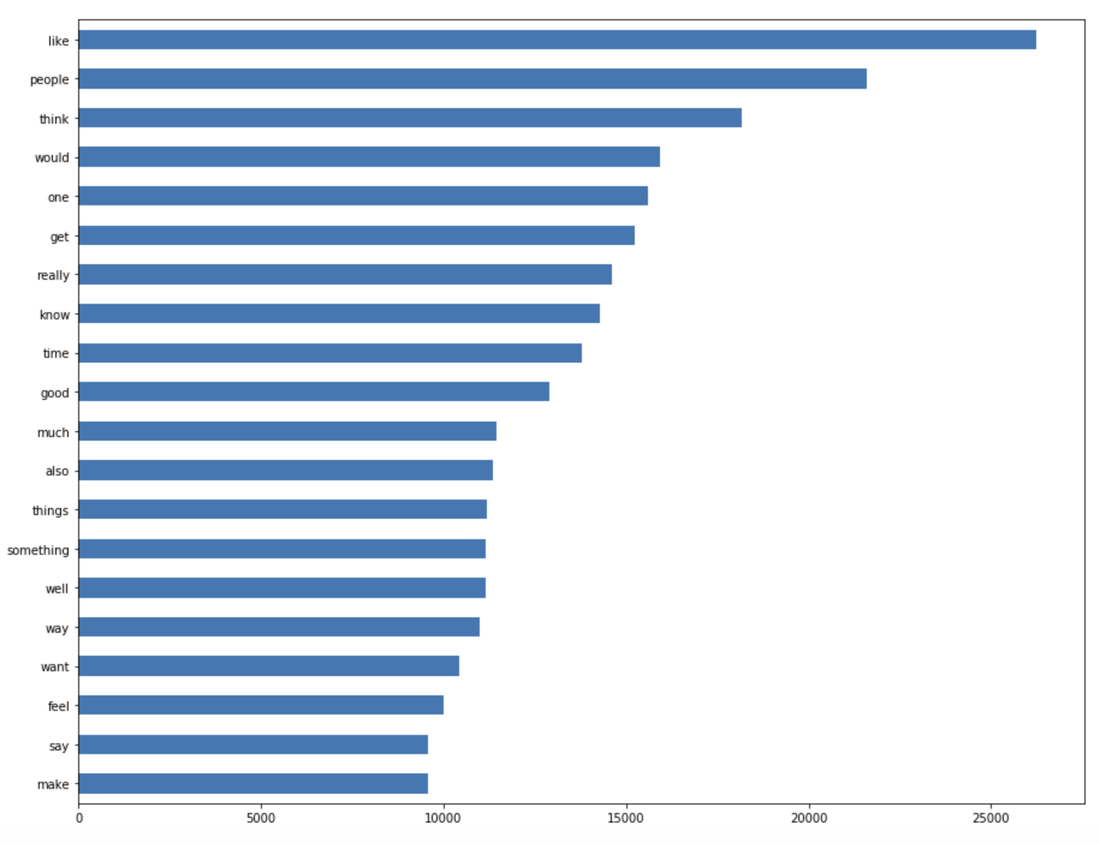

Slide 14
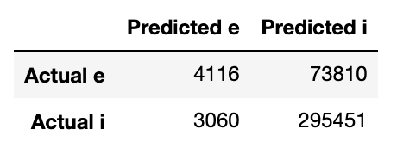
Logistic Regression + Tfidf Vectorizer Model:
79.58% accuracy
Likely predicted I’s correctly more accurately because of data size

Slide 15
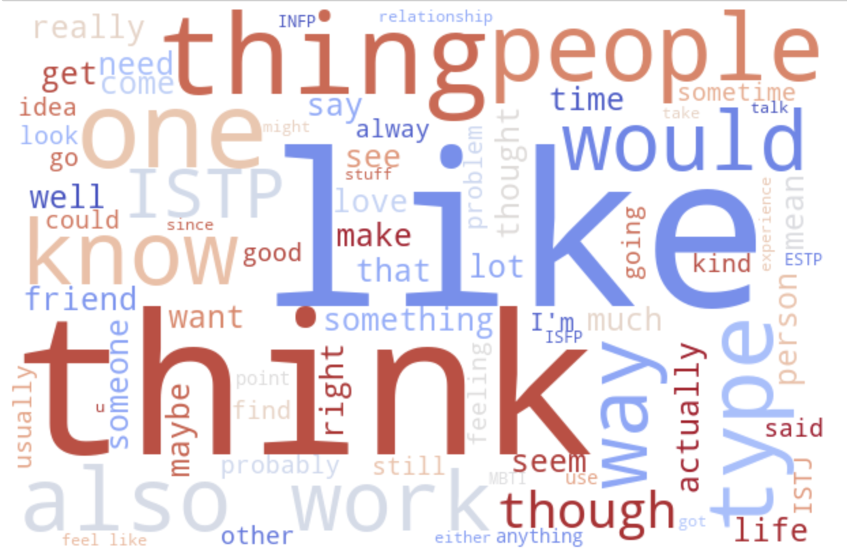
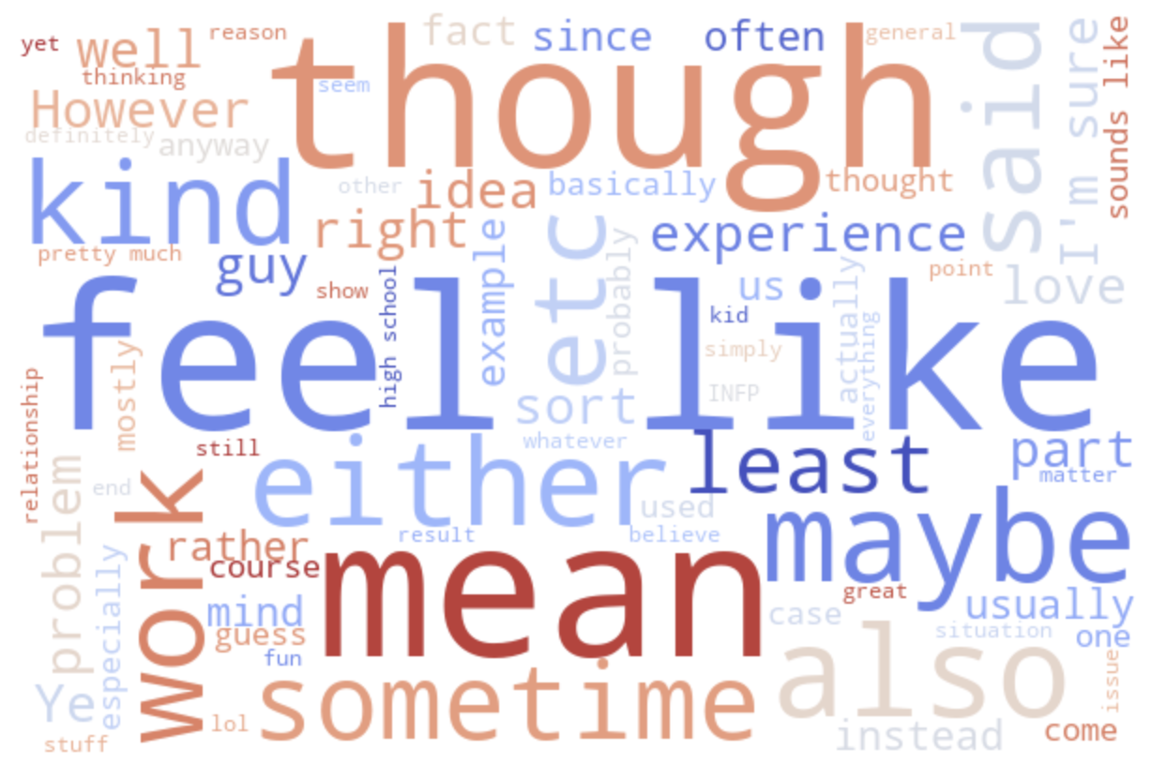
Perception
Sensing & iNtuition

Slide 16
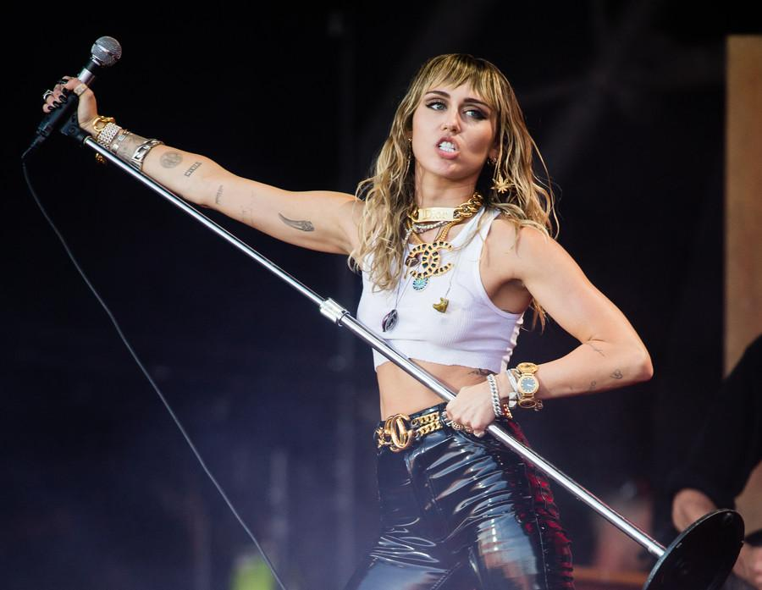

Sensors

Slide 17
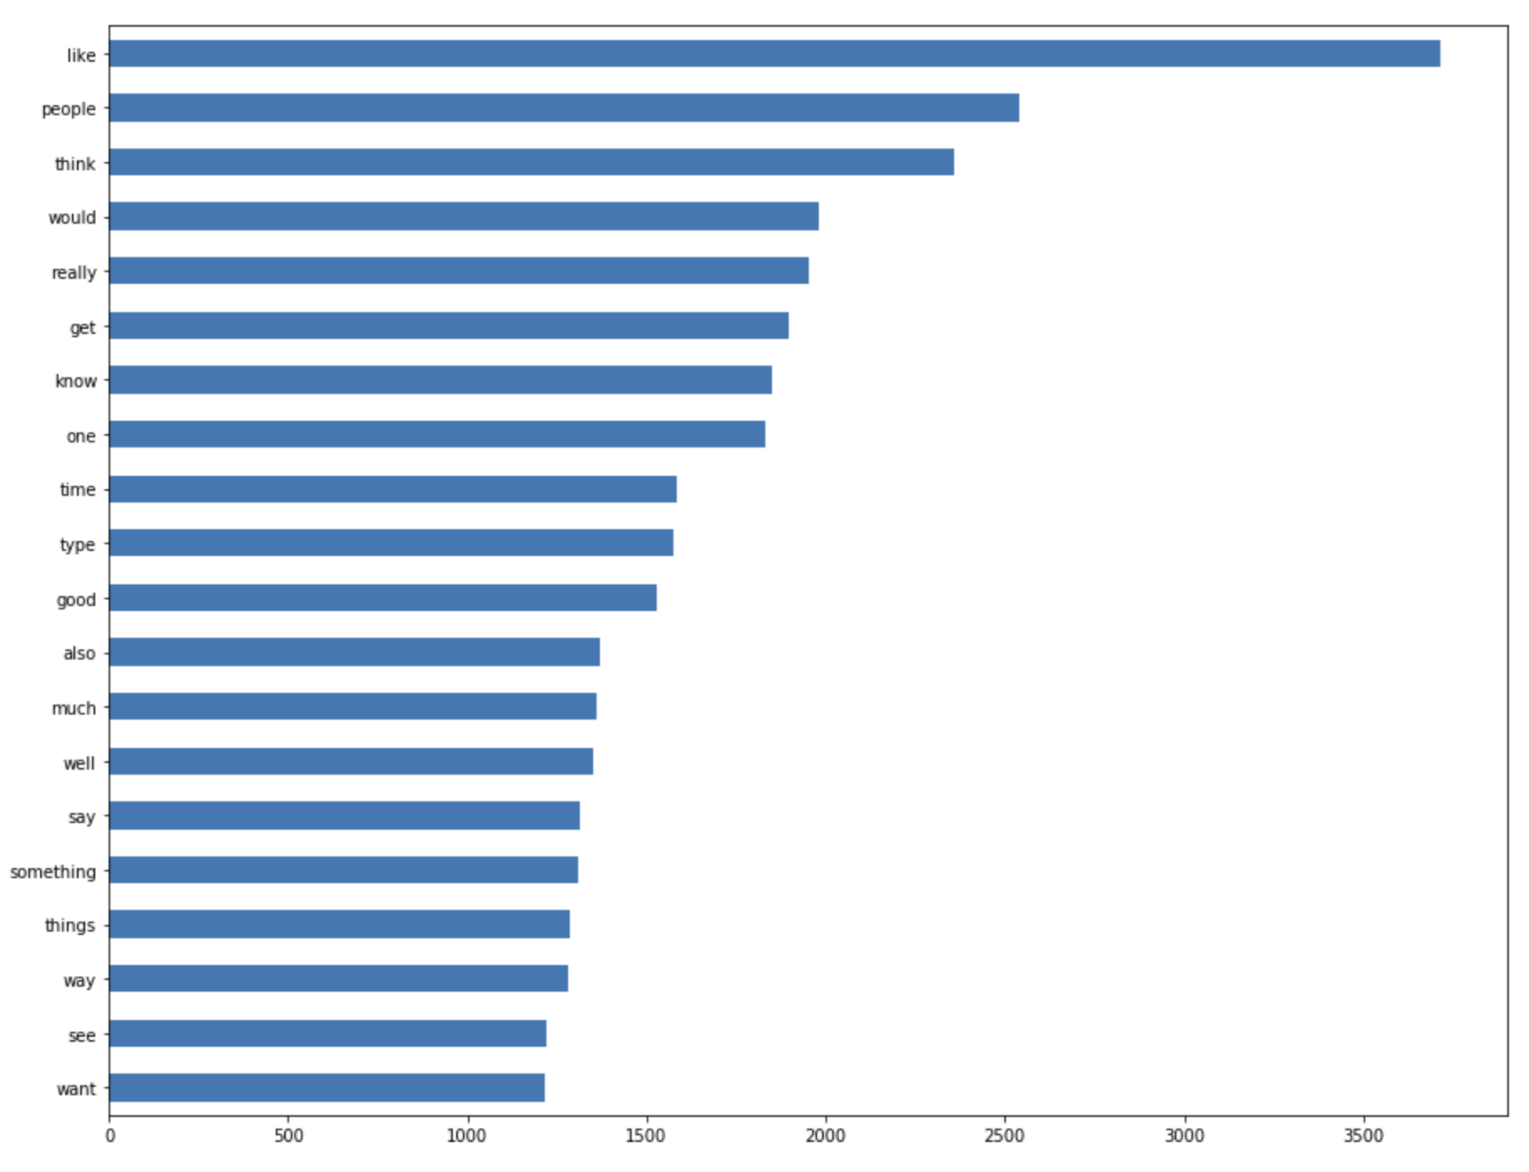

Slide 18


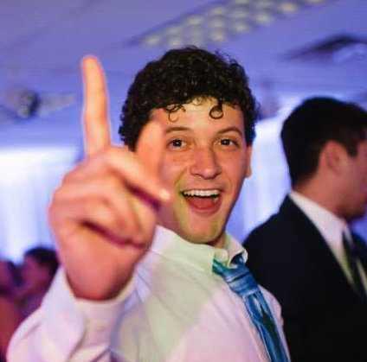
iNtuitives

Slide 19
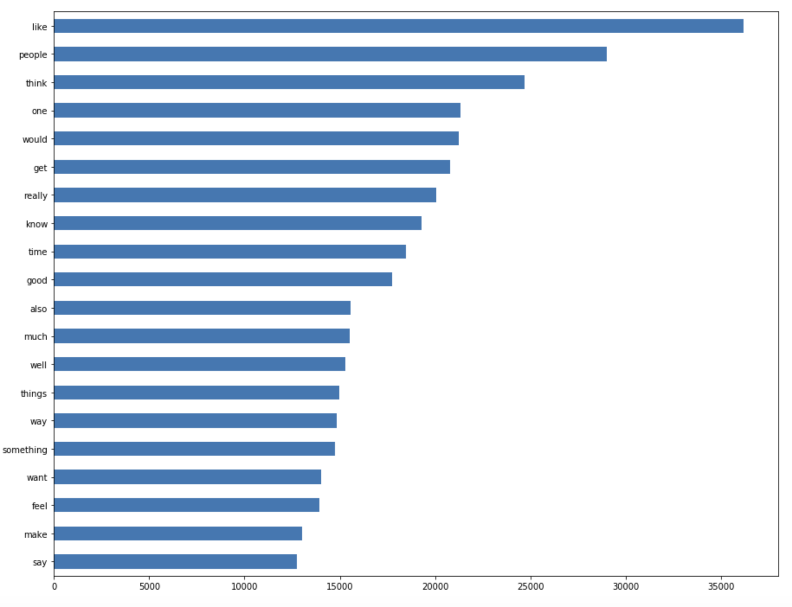

Slide 20
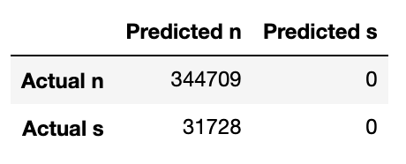
Logistic Regression + Tfidf Vectorizer Model:
91.57% accuracy
Likely predicted all N’s because of data size

Slide 21
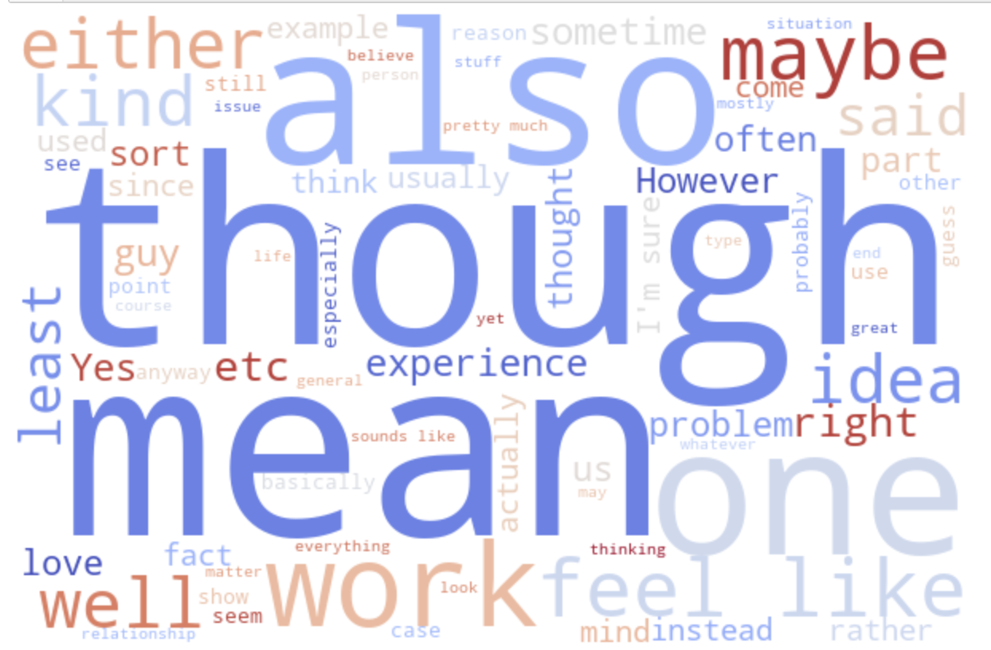
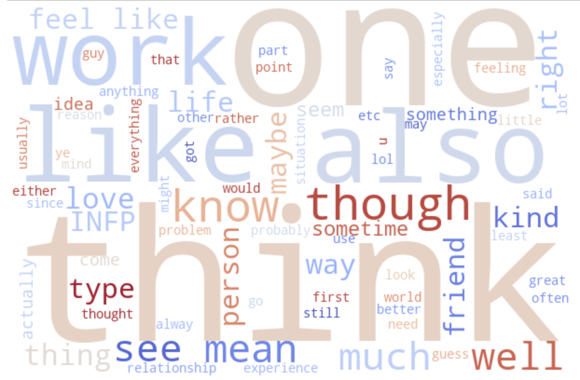
Decision-making
Thinking & Feeling

Slide 22


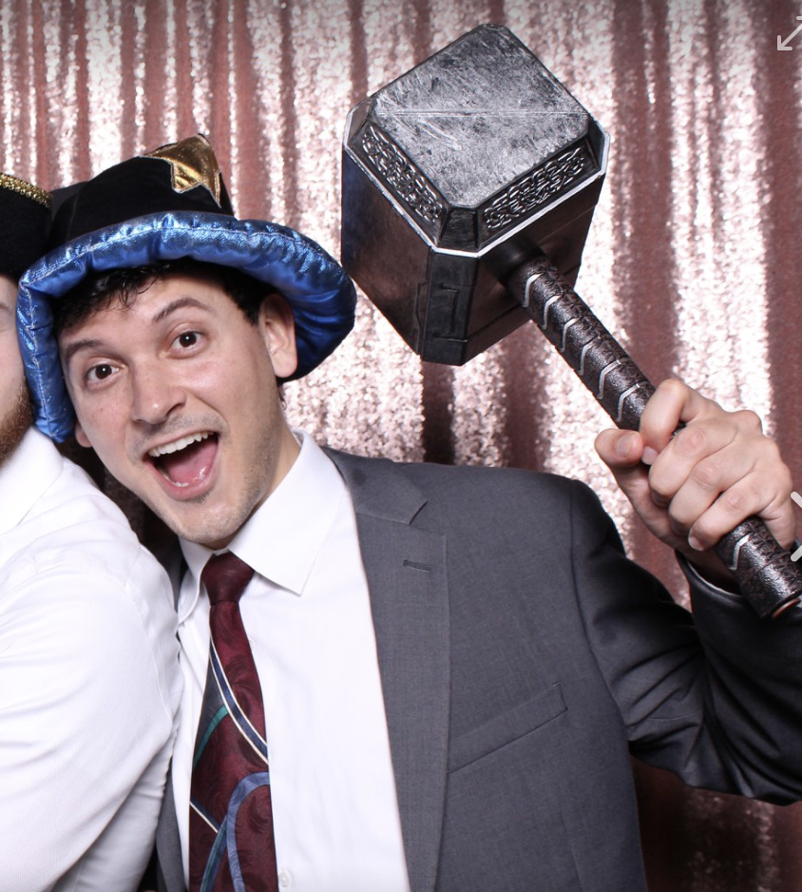
Thinkers

Slide 23
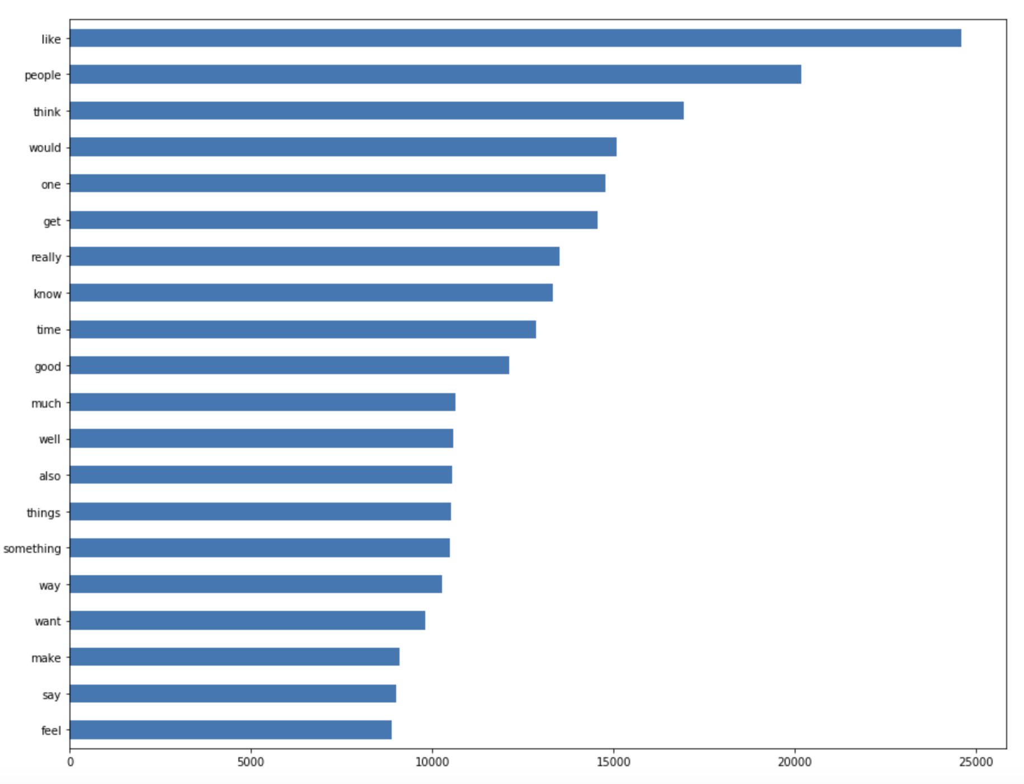

Slide 24
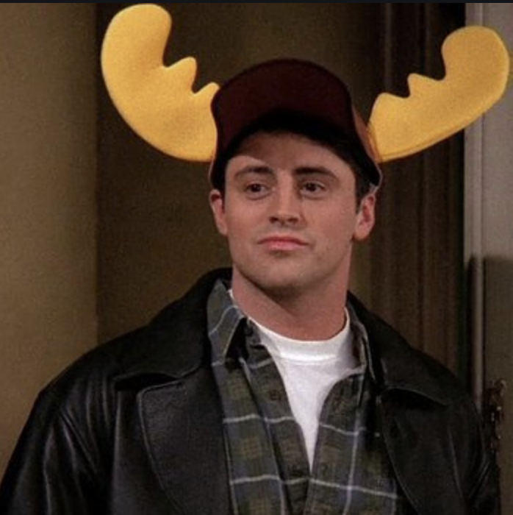


Feelers

Slide 25
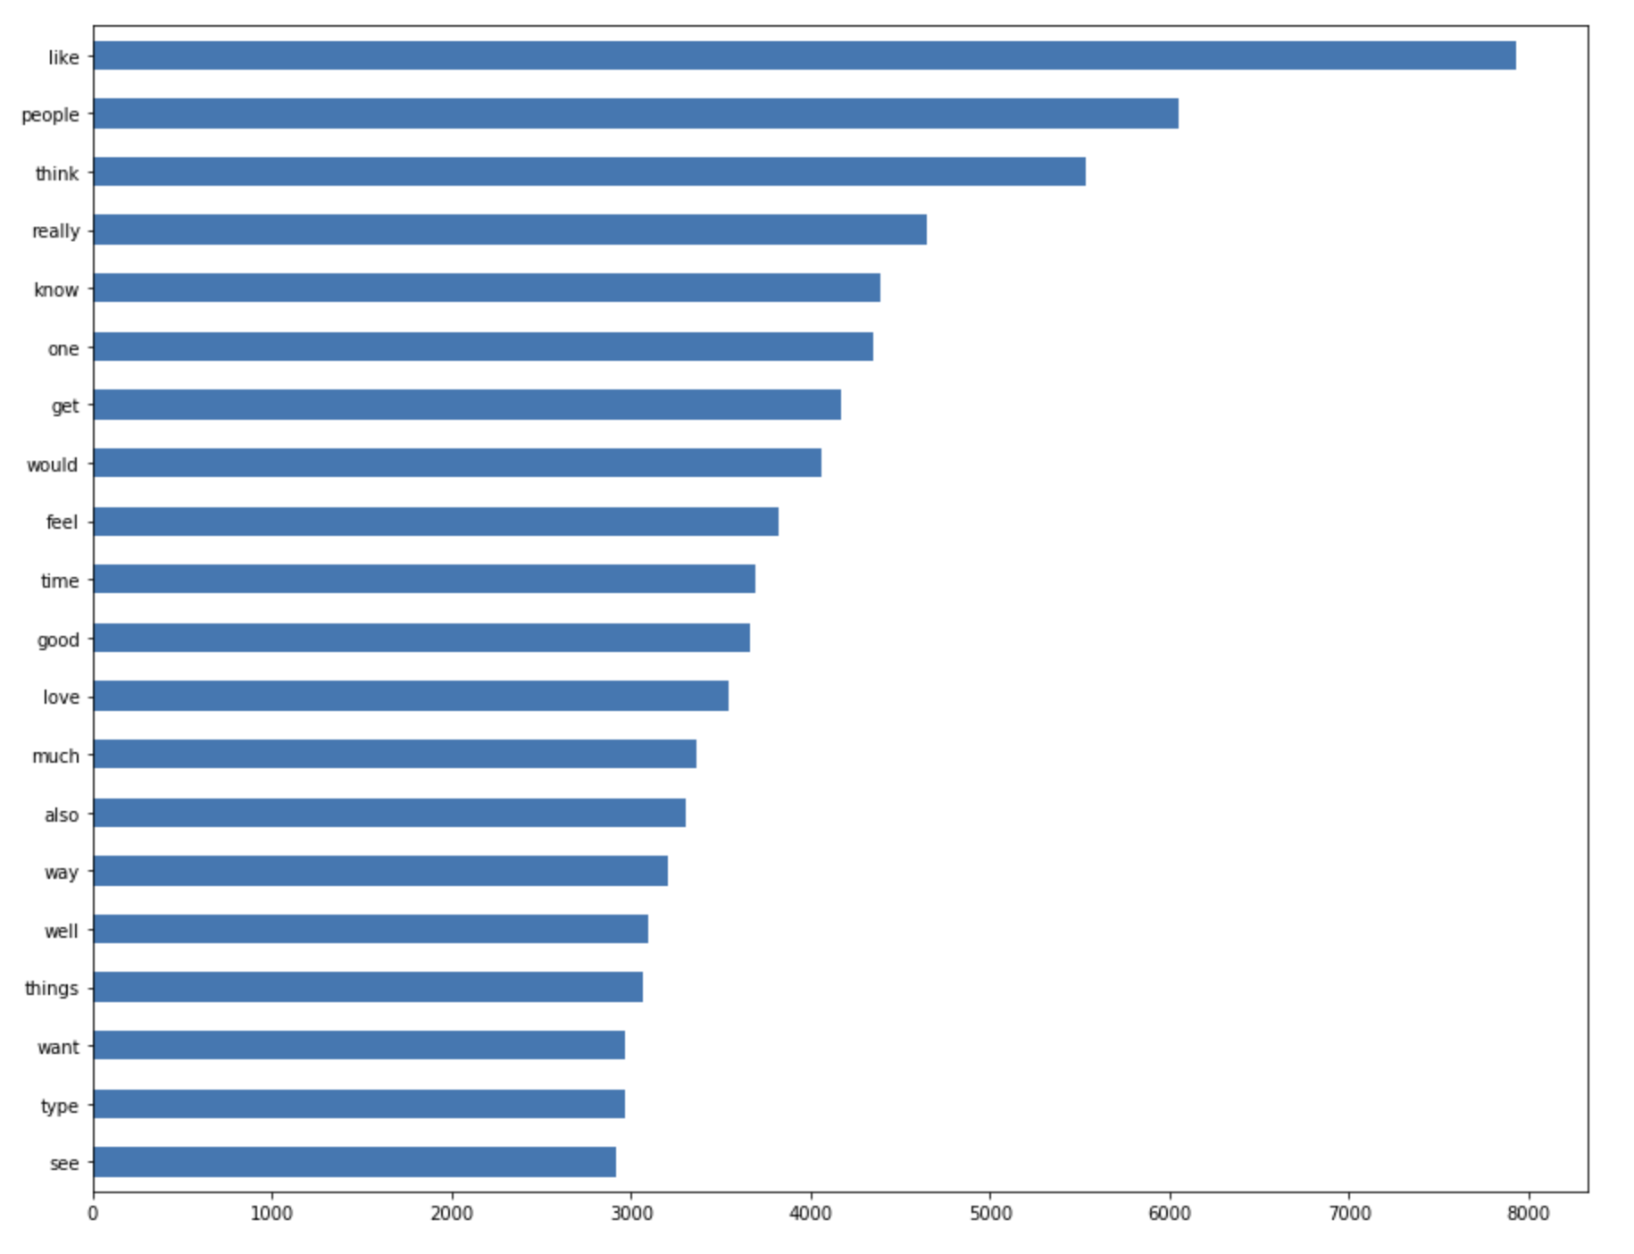

Slide 26
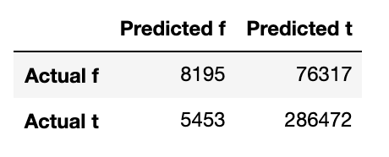
Logistic Regression + Tfidf Vectorizer Model:
78.28% accuracy
Likely based on quantity of T’s and F’s like other models

Slide 27
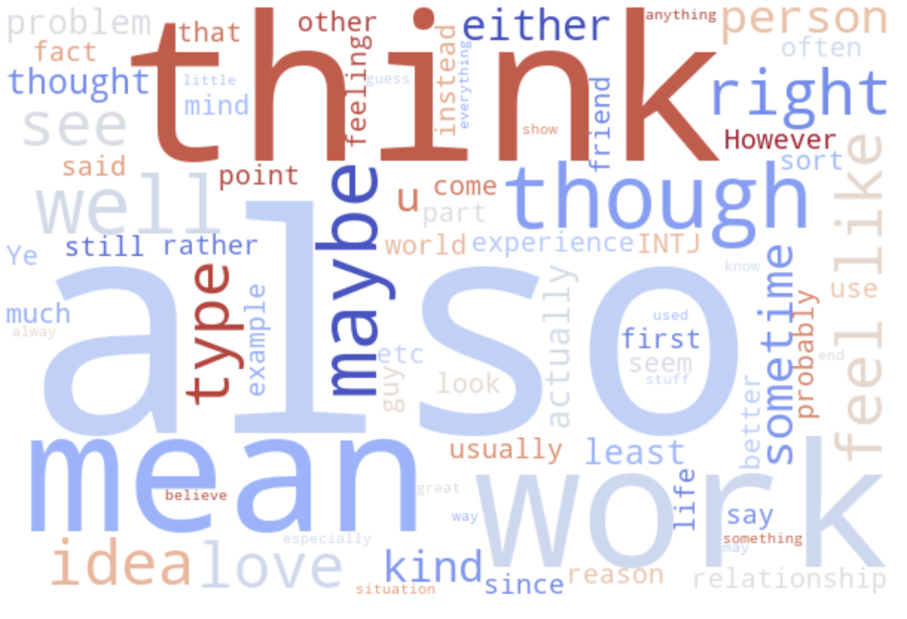
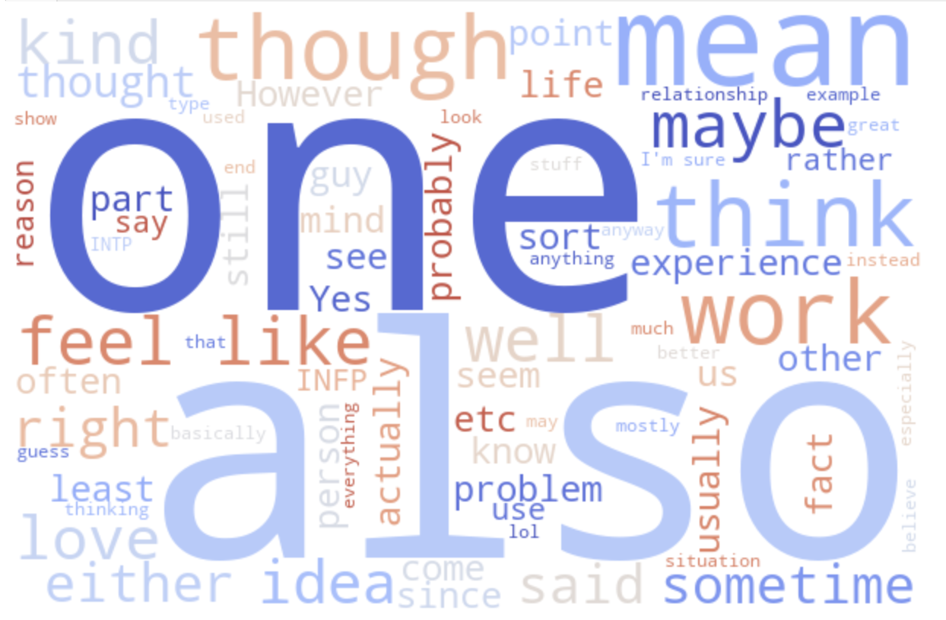
Lifestyle
Judging & Perceiving

Slide 28


Judgers

Slide 29
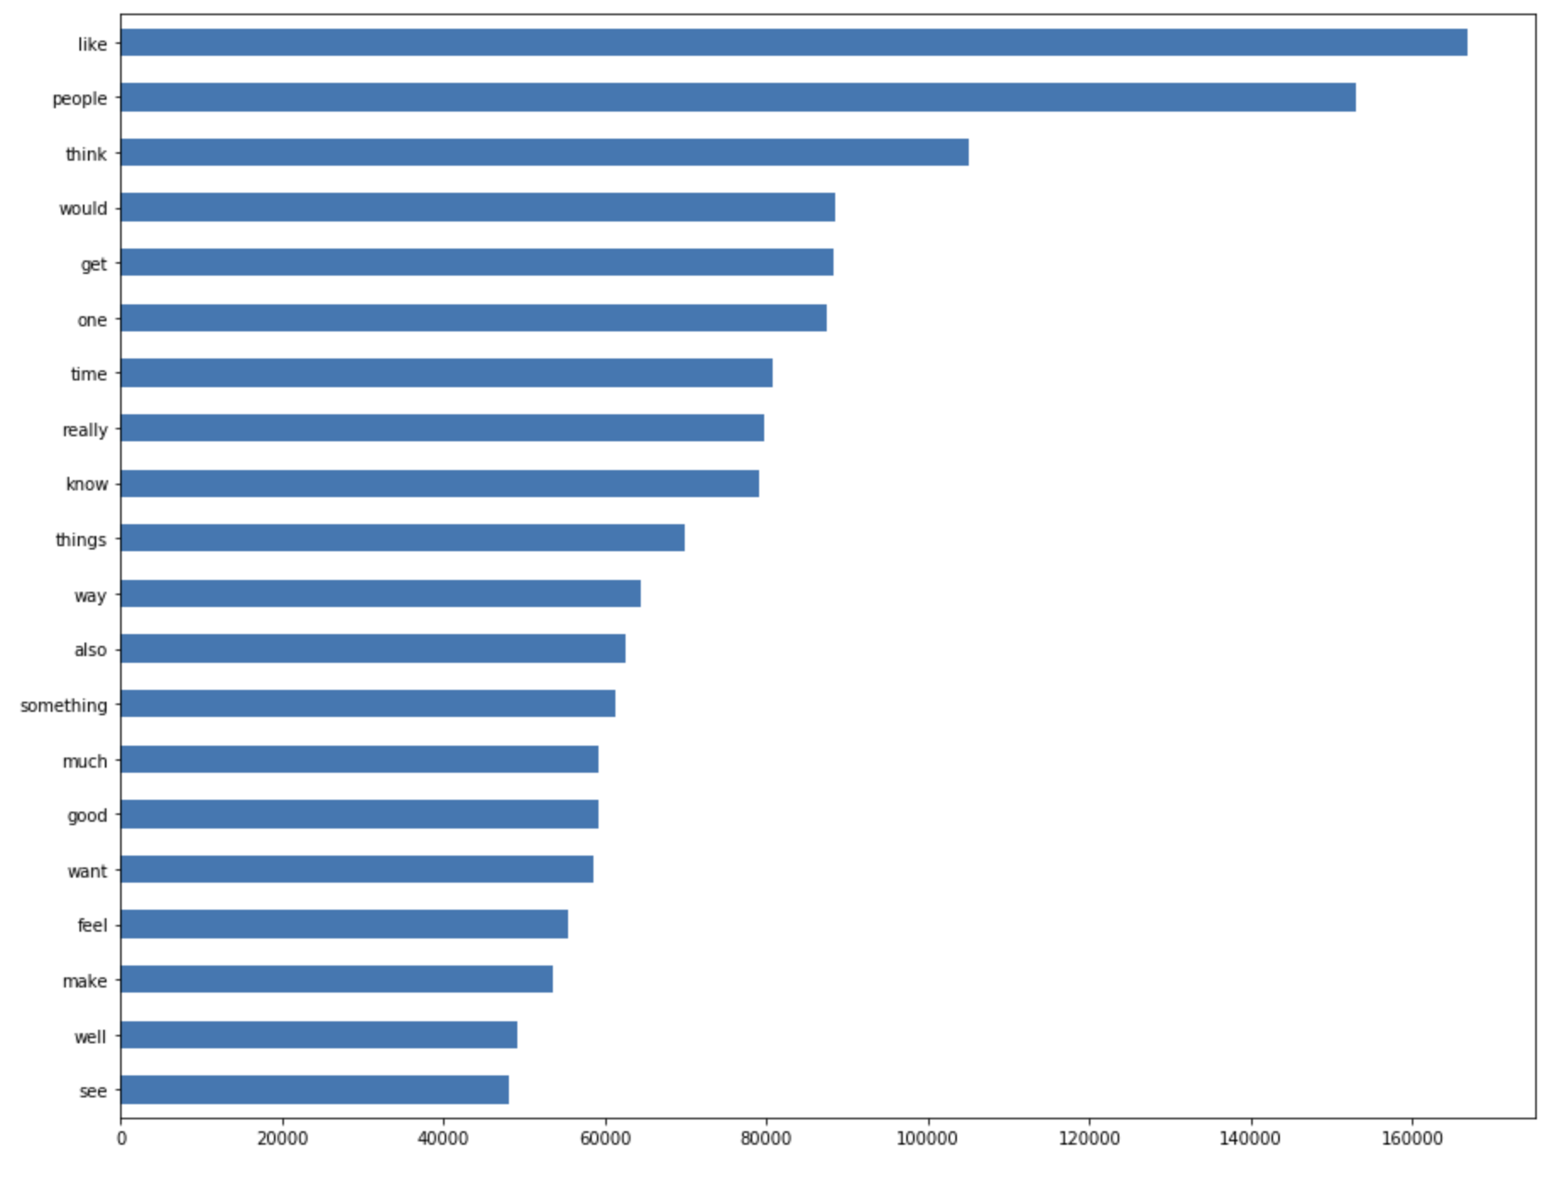

Slide 30



Perceivers

Slide 31
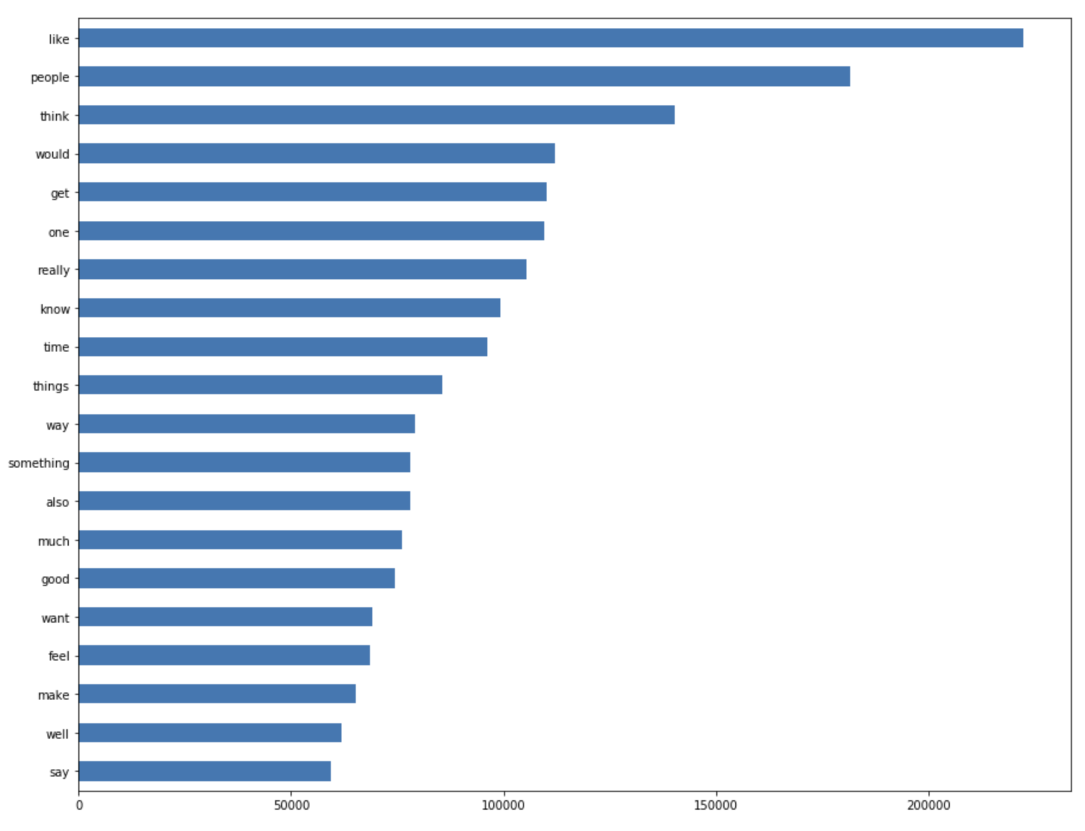

Slide 32
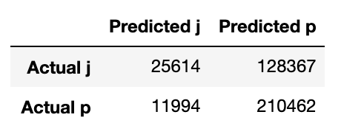
Logistic Regression + Count Vectorizer Model:
62.71% accuracy
A little more P’s than J’s in the data, but the lower accuracy score is likely due to the nature of this category making it more difficult to discern from Reddit comments.

Slide 33

Ideas for future development:
Run models that include only specific stop words that might relate to MBTIs (I, me, myself, my vs. you, your, yourself could indicate E vs I).
For visualization create a scatterplot that shows you how often a word is used by one MBTI trait vs another. This could be cross-category to identify trends between SJ’s, NP’s, etc. It would require a large amount of and very specific data.
Use neural networking to identify the substance of bodies of text more accurately and then to make more sophisticated predictions of MBTI based on discussion topics, not just individual words.
Goal: create a model sophisticated and accurate enough to scan texts/messages in real time and identify personality type, which could then be used to make recommendations for how to communicate with groups or individuals.

Slide 34
